Slide 1
ORGANIZATION NAME : CDK Global
PROBLEM STATEMENT : Portal for Farmers to sell their produce at a better rate.
System that provides farmers an interface to sell their product, and connect with the buyers all over India.
Simple interface that works on smart devices, SMS to upload product details and respond via phone and SMS .
Interface for anyone to buy the produce/vegetable – initially visit the place and buy or have courier service integrated to deliver the vegetables so Farmers can get a better price for their produce, no additional cost is spent in marketing and delivery of goods, however they can choose to charge more by delivering the items themselves.
PROBLEM CODE : RA27
TEAM LEADER NAME : Abhishek Gupta
COLLEGE CODE : #2274
TEAM NAME : S-Park.
S-Park is a smart parking system, with a pure vision to eliminate time wastage at parking spaces and increase the security factors. It helps in reducing human labour, fuel consumption and pollution ensuring the efficiency and reliability of the parking system.

Slide 2
The automated system will detect the number plate of the vehicle at the entrance and exit(classifiation algo)
GATE
The vacant parking spots in each floor will be made visible on site and on the app after which he can move toward his desired floor.(
The vehicle type (car, truck, two wheeler) will be noted because every type will have a different parking area.
The registered users can get direct entry using their registered RFID.
If he loses track, he can opt for the “LOST” option, which will detect his location on certain parameters and redirect him.
On the desired floor, the layout of the floor will be displayed (app and LCD on site) with the vacant and occupied highlighted.
parking
On the app, if he clicks on any empty spot, he will be shown directions to that spot.
The user can pay at the cash counter on exit, or use PayTm.

Slide 3
EASY ACCESS.
At the exit, the user has to enter his car number plate(app or on site), and the system will provide the slot number where the car is parked.
BOOKING SYSTEM.
(The user can book his parking slot when he is within 20 meters radius).
SHOWSTOPPERS
BEEP SYSTEM.
If the car is not parked properly (slanted), the beep system will indicate the same.
PARKING ALLOCATION.
Every type of vehicle will have its own parking area. Electric cars will have slots with the charging segment.
LIGHTING SYSTEM.
The color of the lights indicate the occupancy of the slot.
Red-Occupied.
Green-Vacant.
DIMING LIGHTS
When no vehicles in motion are detected, the lights will dim which saves energy.

Slide 4
REGISTERED USERS BENEFITS:
Fixed parking spot.
Monthly payment. (For the time, the parking slot was used)
Net banking. (Automatically money deducted).
All the visit details (entry and exit time) will be visible to him at all times.
If his slot gets occupied by someone else, the admin will be notified immediately.
Dependencies
This application can be installed in all devices having Android version Jellybean and higher.
An online portal generated shall require IE v9 or higher, Google Chrome, Mozilla Firefox, or any other web browser
Hardware components and their installation and power supply.
Conventional v/s S-Park
Technology Stack
Modern Technology :- Data Preprocessing, Visualization, Machine learning and Deep learning, Cloud Computing.
Mobile Development :-Android Studio, Android SDK and Jellybean version and above.
Web Technology : - HTML, CSS, JavaScript, AJAX, Bootstrap , Django and nodeJS .
Backend Development :- Firestore and Firebase.
Hardware Components :- Raspberry pi 4,RFID,Sensors,Servo motors , Camera , LCD , BULB ,etc .

Slide 5
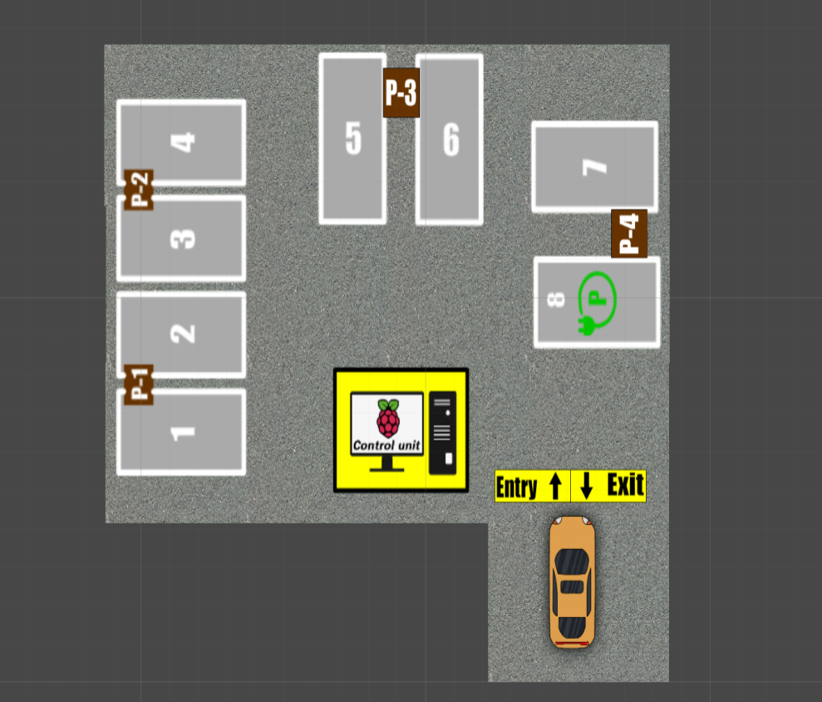
DATA COLLECTION
At the gate, the number plate and the entry-exit time is saved to the database using camera module.
At the parking area, which car(number plate) is parked in which slot is also saved to the database.
DATA LOCAL STORAGE
The images taken by the camera will be locally stored in the raspberry pi.
Once the data is processed, the raspberry will automatically free the data.
DATA PROCESSING
The number plate detection, motion detection, entry-exit time detection will take place.
The output of the processed data will be stored in the cloud.
DATA CLOUD STORAGE
The filtered output will be stored in the cloud. The data required for the android app and the website that has to be shown to the user, will be retrieved from the cloud.
DATA VISUALIZATION
The information which concerns the user will be shown in the android app and the website.
This information includes the map guidance, the number of available slots, etc.

Slide 6
DATA COLLECTION
At the gate, the number plate and the entry-exit time is saved to the database using camera module.
At the parking area, which car(number plate) is parked in which slot is also saved to the database.
DATA LOCAL STORAGE
The images taken by the camera will be locally stored in the raspberry pi.
Once the data is processed, the raspberry will automatically free the data.
DATA PROCESSING
The number plate detection, motion detection, entry-exit time detection will take place.
The output of the processed data will be stored in the cloud.
DATA PROCESSING
The number plate detection, motion detection, entry-exit time detection will take place.
The output of the processed data will be stored in the cloud.
DATA VISUALIZATION
The information which concerns the user will be shown in the android app and the website.
This information includes the map guidance, the number of available slots, etc.

